Slide 1
WHAT IS AIR QUALITY?
How clean the air clean the air is around us

Slide 2
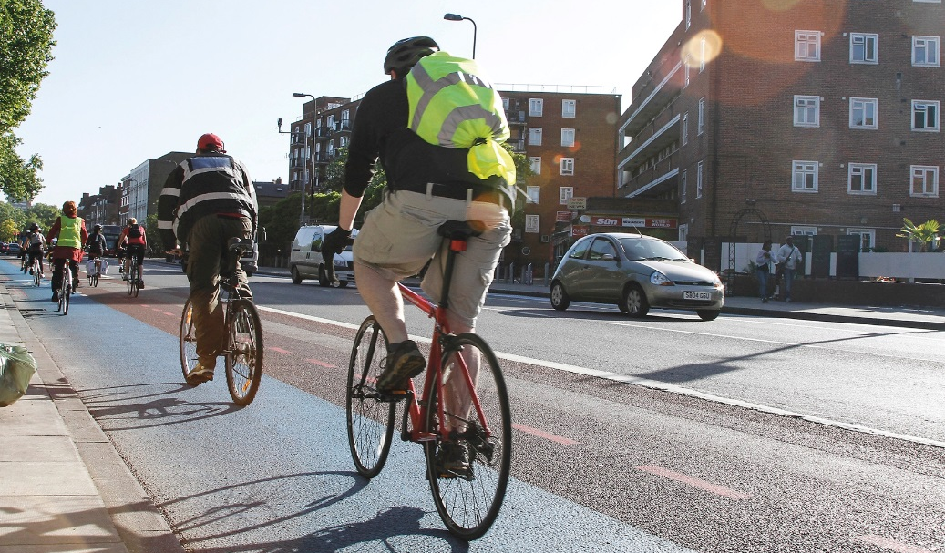
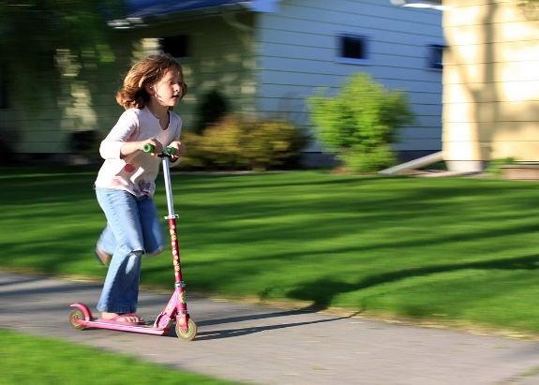
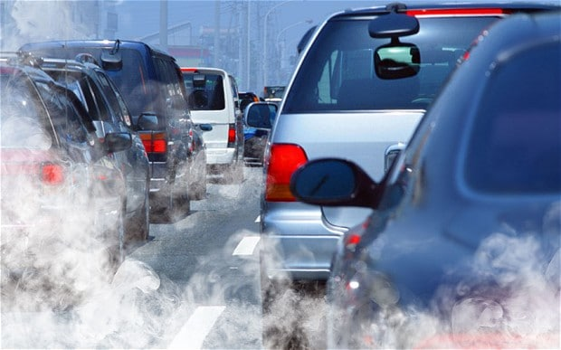
How did you get to work?
Do you… Walk? Cycle? Scoot?
Bus? Train? Taxi? Drive?
Which of these ways of travelling do they think are worst for making air pollution?
Which of these ways make the least air pollution?
Notes:
Air pollution can be caused when we burn fossil fuels such as coal, natural gas, diesel or petrol.
We use these energy supplies for cooking and washing at home, for turning on our lights, heating our homes and travelling by car.
The most concerning pollutants that can make you unwell:
Nitrogen Dioxide (NO₂): this can irritate the lining of your lungs.
Particulate Matter (PM) – these are tiny particles of dust, soot or liquid which are too small to see. These can sometimes go deep into your lungs.
Nowadays, when it comes to air pollution – road transport is the biggest problem. Cars, lorries and buses on our roads. Diesel vehicles are the worst of all.
What is diesel? Like you can put your petrol in your car to make the engine work, you can put diesel in your car instead.
Take a show of hands from pupils to find out how many of them drive to school, how many walk, ride or scooter, and how many use public transport.
Which of these ways of travelling do they think are worst for making air pollution? Which of these ways make the least air pollution?

Slide 3
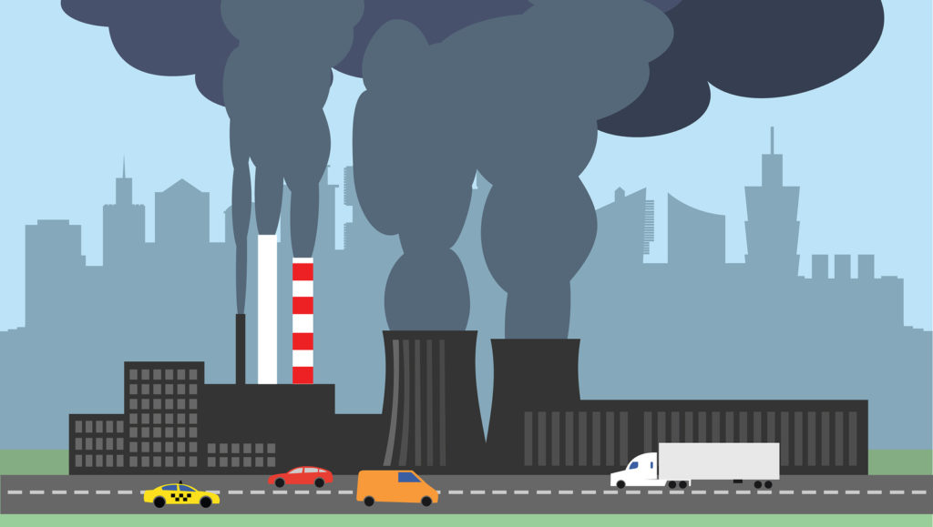
WHERE DOES AIR POLLUTION COME FROM?

Slide 4
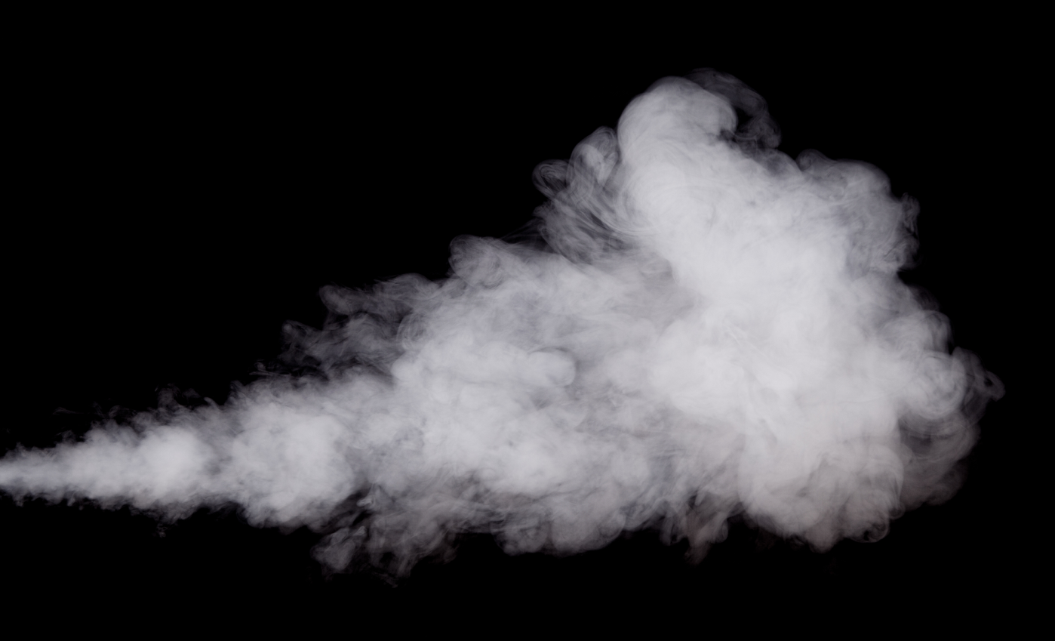
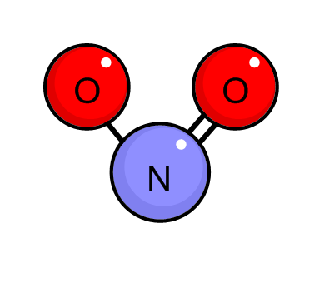
Fine Particulates
PM10 and PM2.5
Cars give off some poisonous gases
Nitrogen Dioxide
NO2
Notes:
Talk to pupils about the effect of air pollution on their health.
Air pollution can contribute to breathing problems, the development of asthma, and lung and heart diseases. The risks are greater for children, as your bodies are less resilient and still developing. Because of your height, you are also closer to the exhaust fumes from cars. Studies have also shown that living in very polluted areas can stop your lungs growing properly, which could cause health problems later in life. But if we do something about it and cut pollution, we can reverse some of this damage.
What other impact does air pollution have on the environment? Pupils may also know about how burning fossil fuels also creates global warming. As well as causing acid rain, which can affect plants and trees.

Slide 5
WHAT’S THE PROBLEM?
Health
Environment
Notes:
Talk to pupils about the effect of air pollution on their health.
Air pollution can contribute to breathing problems, the development of asthma, and lung and heart diseases. The risks are greater for children, as your bodies are less resilient and still developing. Because of your height, you are also closer to the exhaust fumes from cars. Studies have also shown that living in very polluted areas can stop your lungs growing properly, which could cause health problems later in life. But if we do something about it and cut pollution, we can reverse some of this damage.
What other impact does air pollution have on the environment? Pupils may also know about how burning fossil fuels also creates global warming. As well as causing acid rain, which can affect plants and trees.

Slide 6
Health

Slide 7
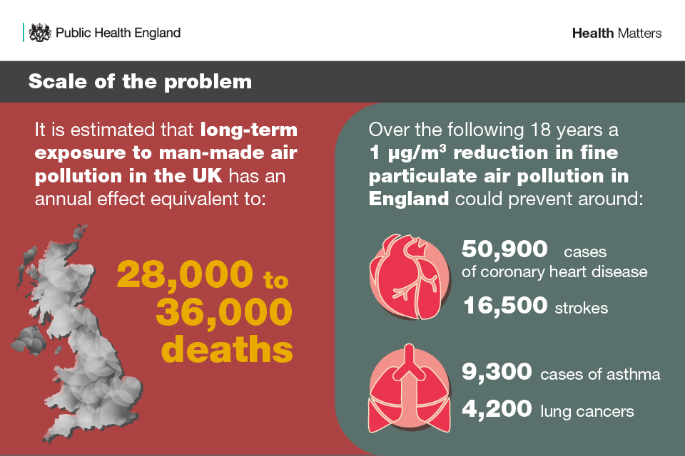
Health

Slide 8
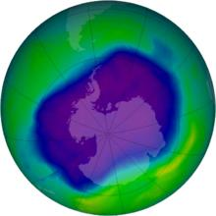
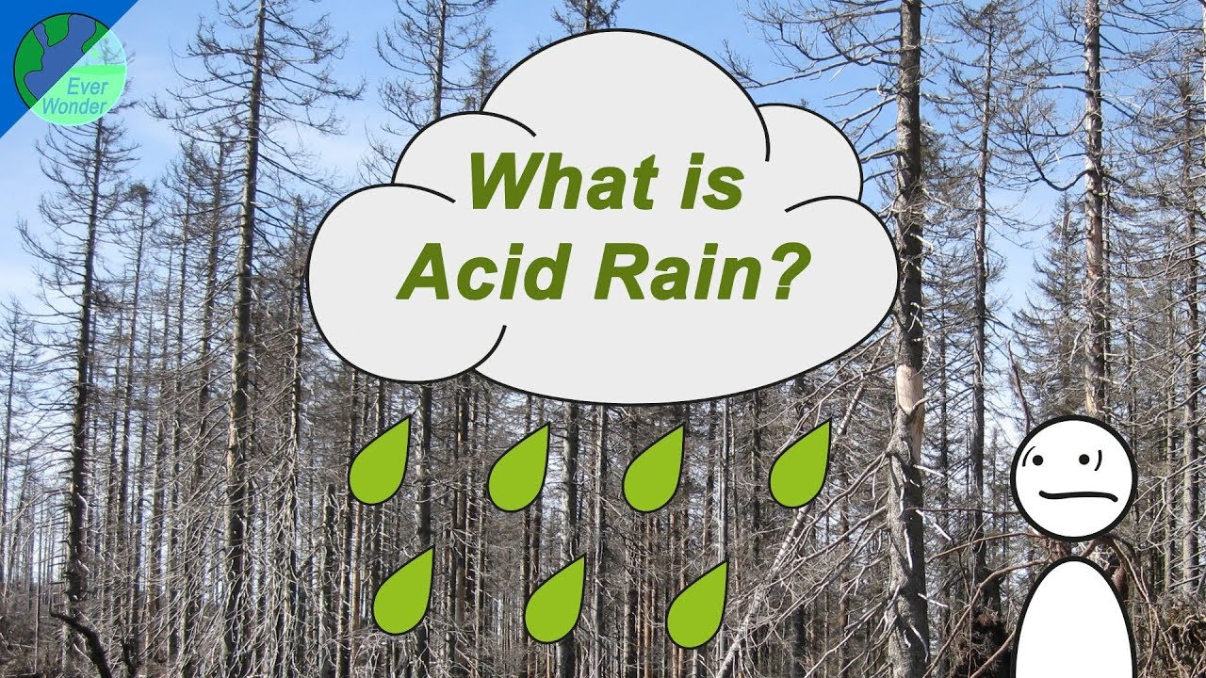
Environment
Global Warming
Nitrogen Dioxide
NO2
Sulpher Dioxide
SO₂
Notes:
Talk to pupils about the effect of air pollution on their health.
Air pollution can contribute to breathing problems, the development of asthma, and lung and heart diseases. The risks are greater for children, as your bodies are less resilient and still developing. Because of your height, you are also closer to the exhaust fumes from cars. Studies have also shown that living in very polluted areas can stop your lungs growing properly, which could cause health problems later in life. But if we do something about it and cut pollution, we can reverse some of this damage.
What other impact does air pollution have on the environment? Pupils may also know about how burning fossil fuels also creates global warming. As well as causing acid rain, which can affect plants and trees.

Slide 9
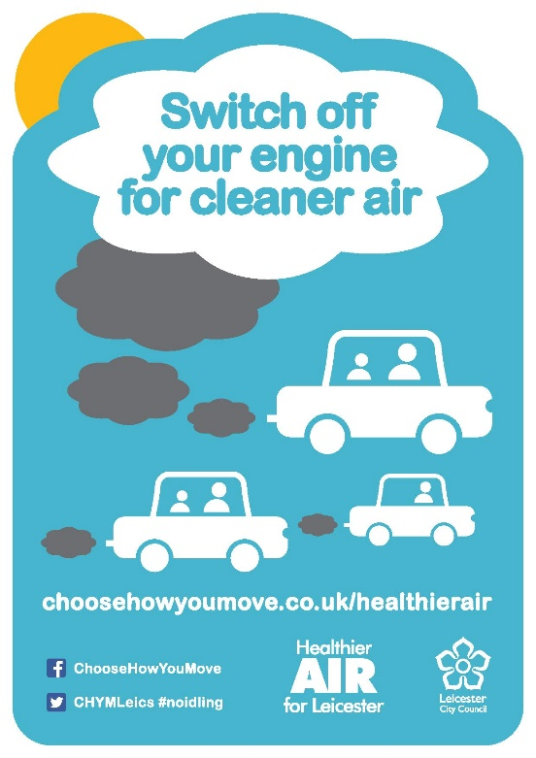
What could your school…
Do today?
Do next week?
Do this term?
Do this year?
Car free day
Active travel day!
Anti-idling
campaign!
Lights off campaign!
Notes:
See lesson 3 for suggestions for how to spread the messages – e.g. create a song or jingle, make an internet meme, design a poster or bumper sticker with a catchy slogan.

Slide 10
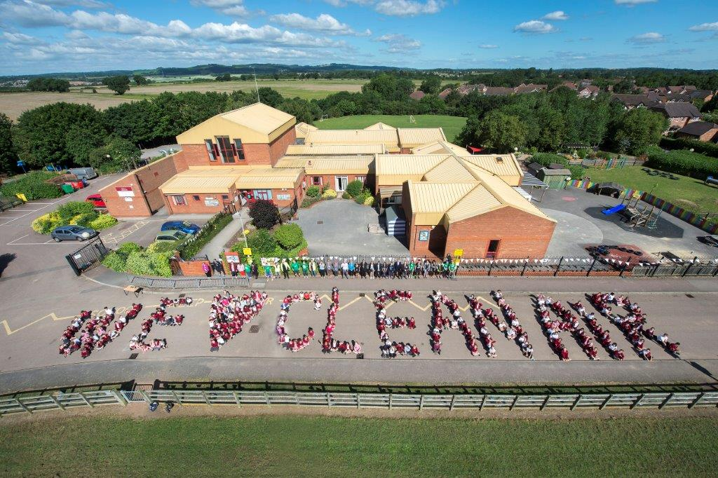
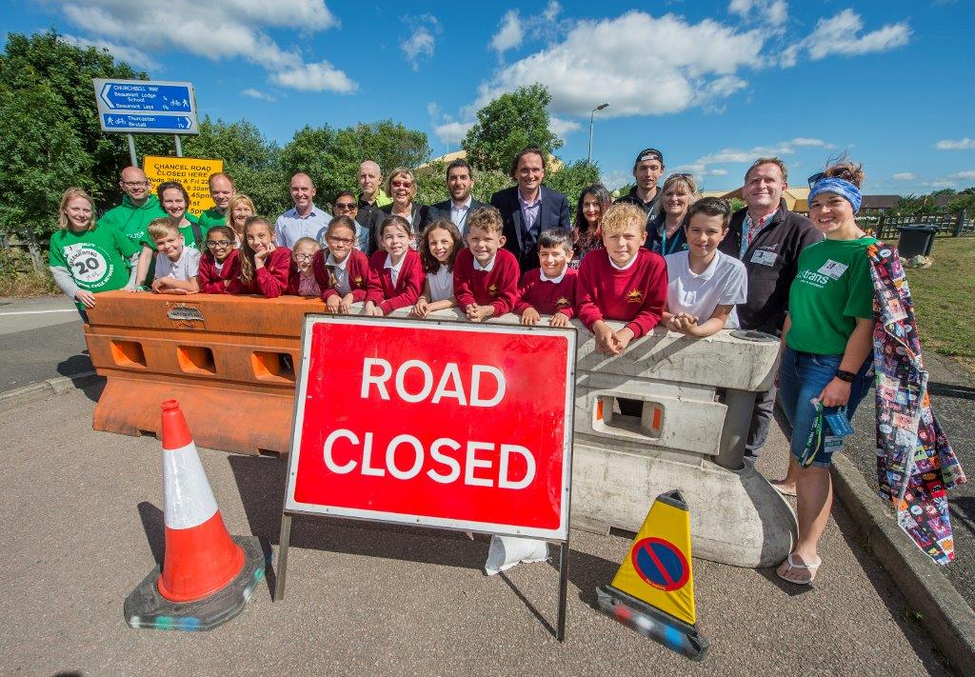
over 300 children and 150 parents attended.
Nearly 60 children and staff arrived by bike on Clean Air Day and 43 arrived by scooter.
The road directly outside Glebelands Primary School was closed, during school run hours, on Wednesday 20 June and Friday 22 June. On Thursday 21 June the road was closed to traffic all day for Clean Air Day.

Slide 11
Thank you!
Danni Kennell
Education Officer (Air Quality) Leicester City Council
danielle.kennell@leicester.gov.uk
Any questions?

