Slide 1
Anti-bullying Award
Uplands Junior L.E.A.D. Academy
Ruth Gatherum

Slide 2
September 2016 committed to the charter for action to work for the Leicester City Anti-bullying Award (Roar like a lion)
Task force- Head teacher, Deputy Head (Anti-bullying champion), SENCo, Lunch time manager, Administrator, Learning Mentor, two pupils, two parents
Initial audit
Action plan with a time line

Slide 3
Review of : - policies and school web-site - recording and monitoring
Review of policies
Anti-bullying
Behaviour
Equality
Complaints policy and procedure
Review of recording and monitoring
SIMs behaviour log & My Concern

Slide 4
Anti-bullying week 14- 18th November 2016
Whole school assembly on anti-bullying
Poster competition to raise awareness
Anti-bullying champions(2 pupils & Deputy Head) attended Anti-bullying week conference-Prejudice driven bullying
Local and national guidance on anti-bullying accessible in pamphlets from the school web-site and the foyer
S T O P - Several Times on purpose
Start telling other people

Slide 5
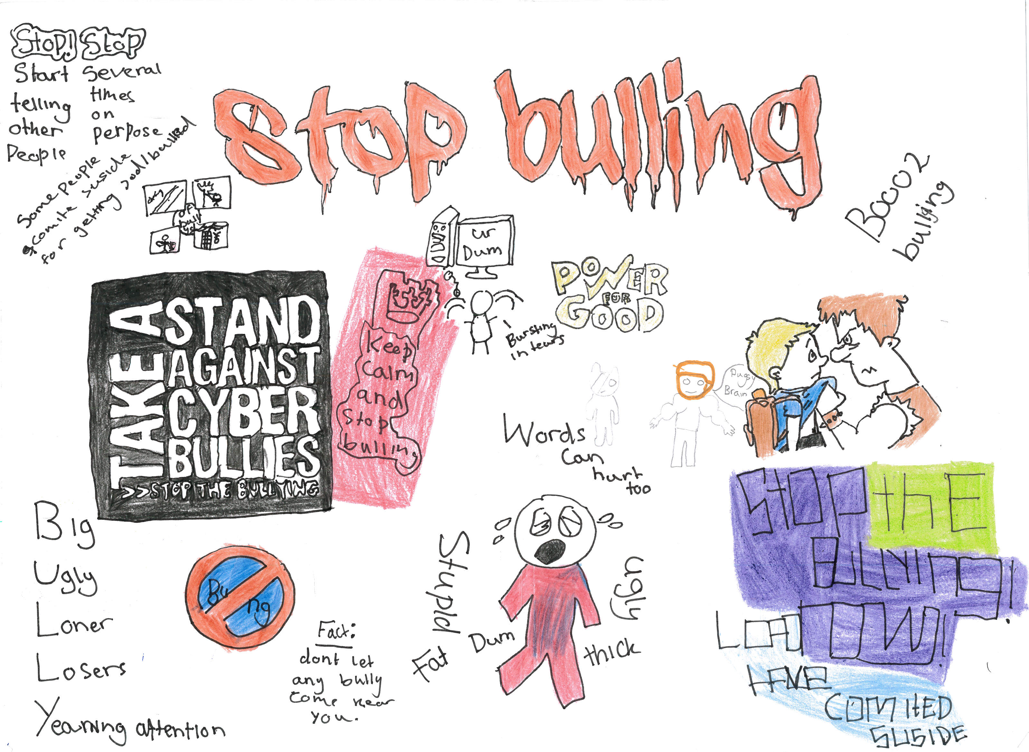
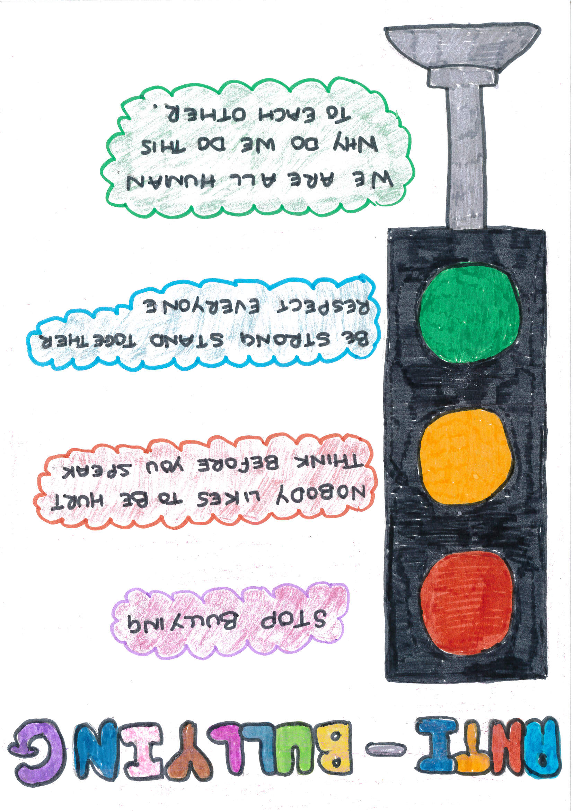
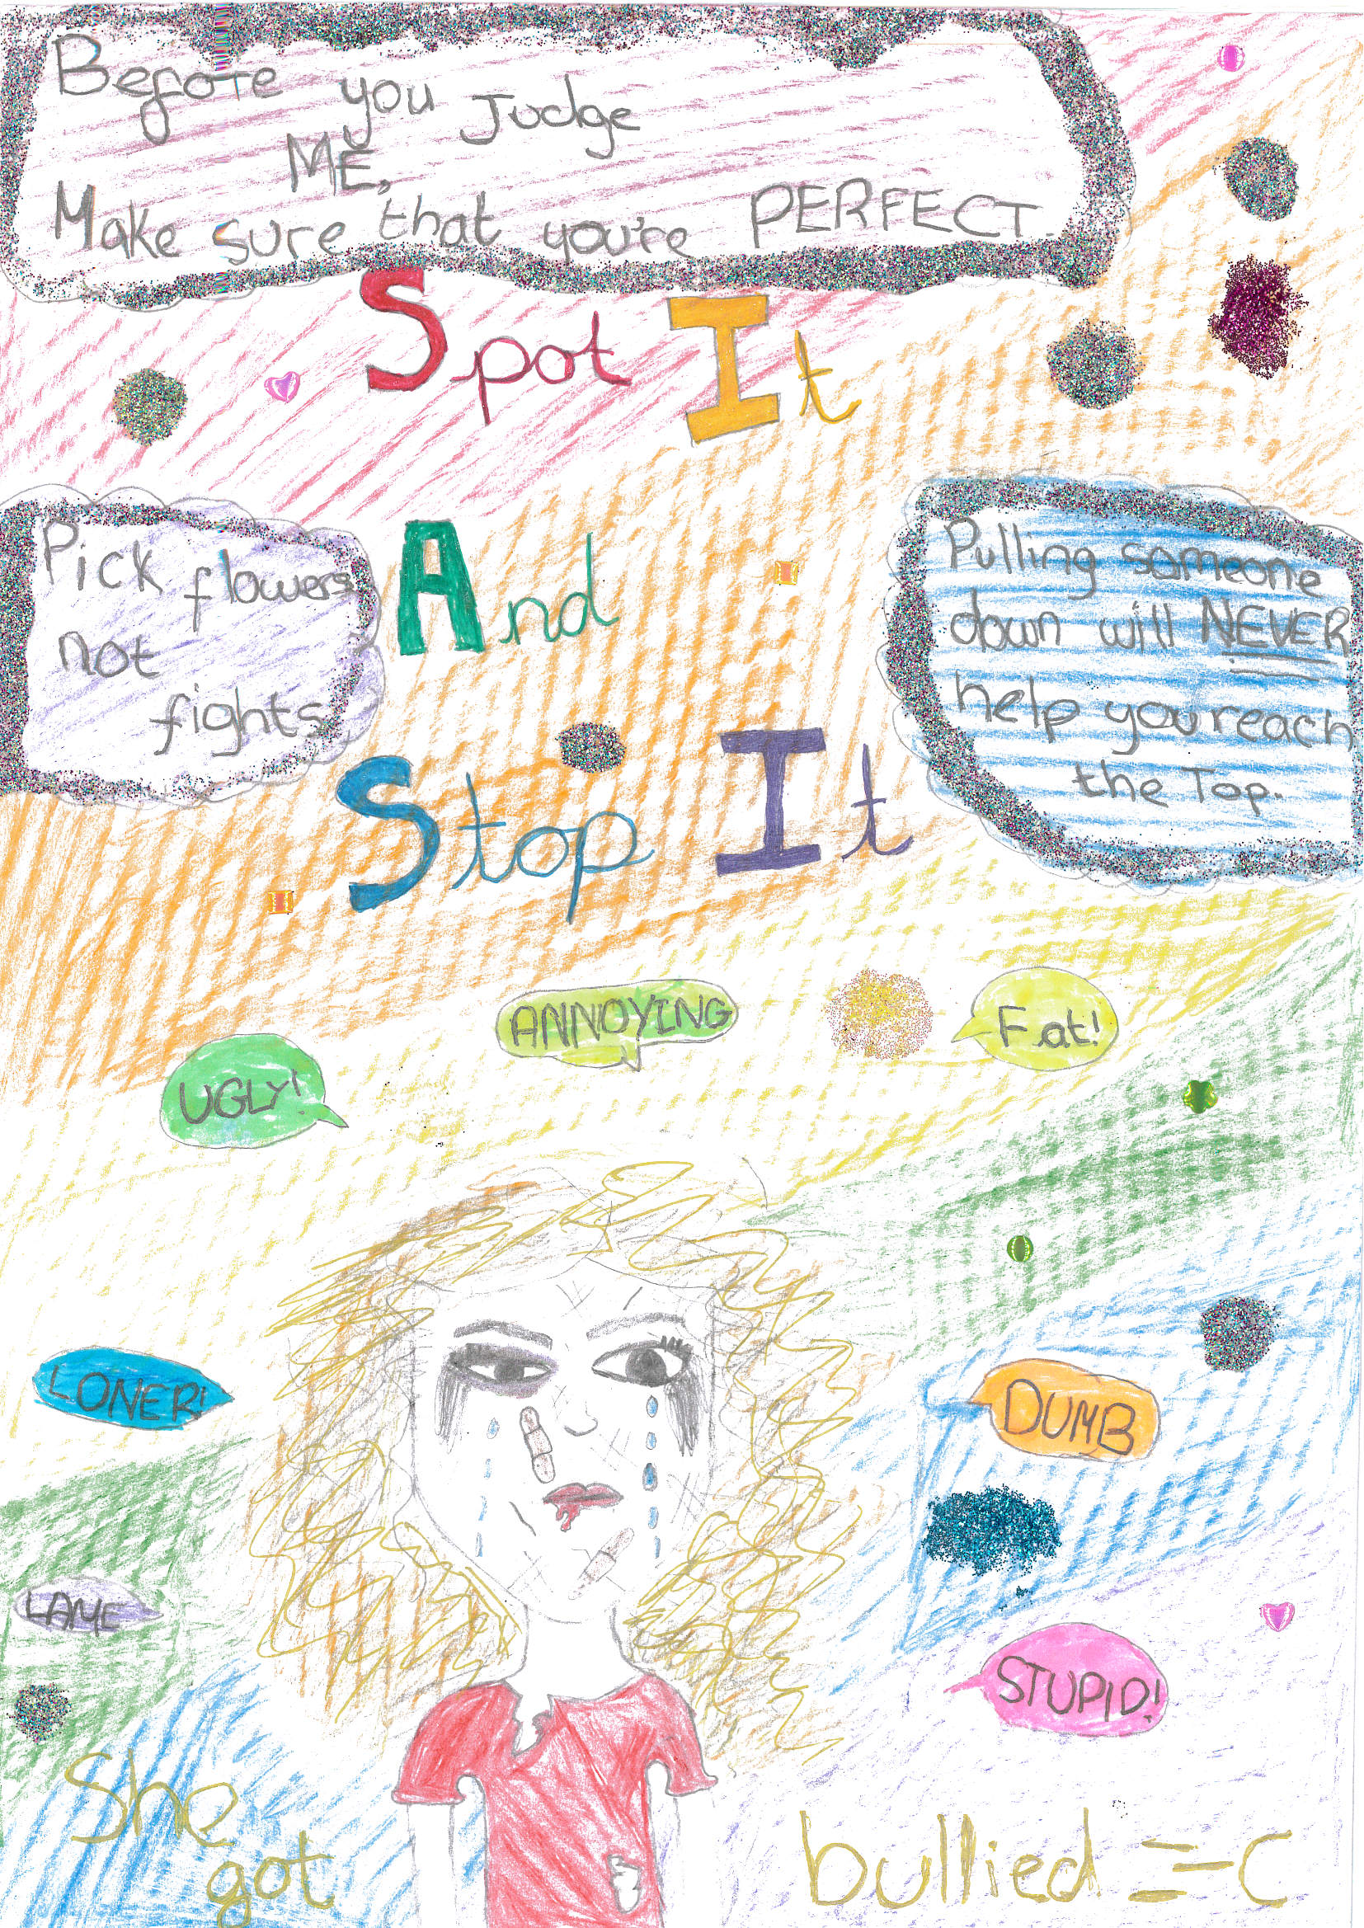
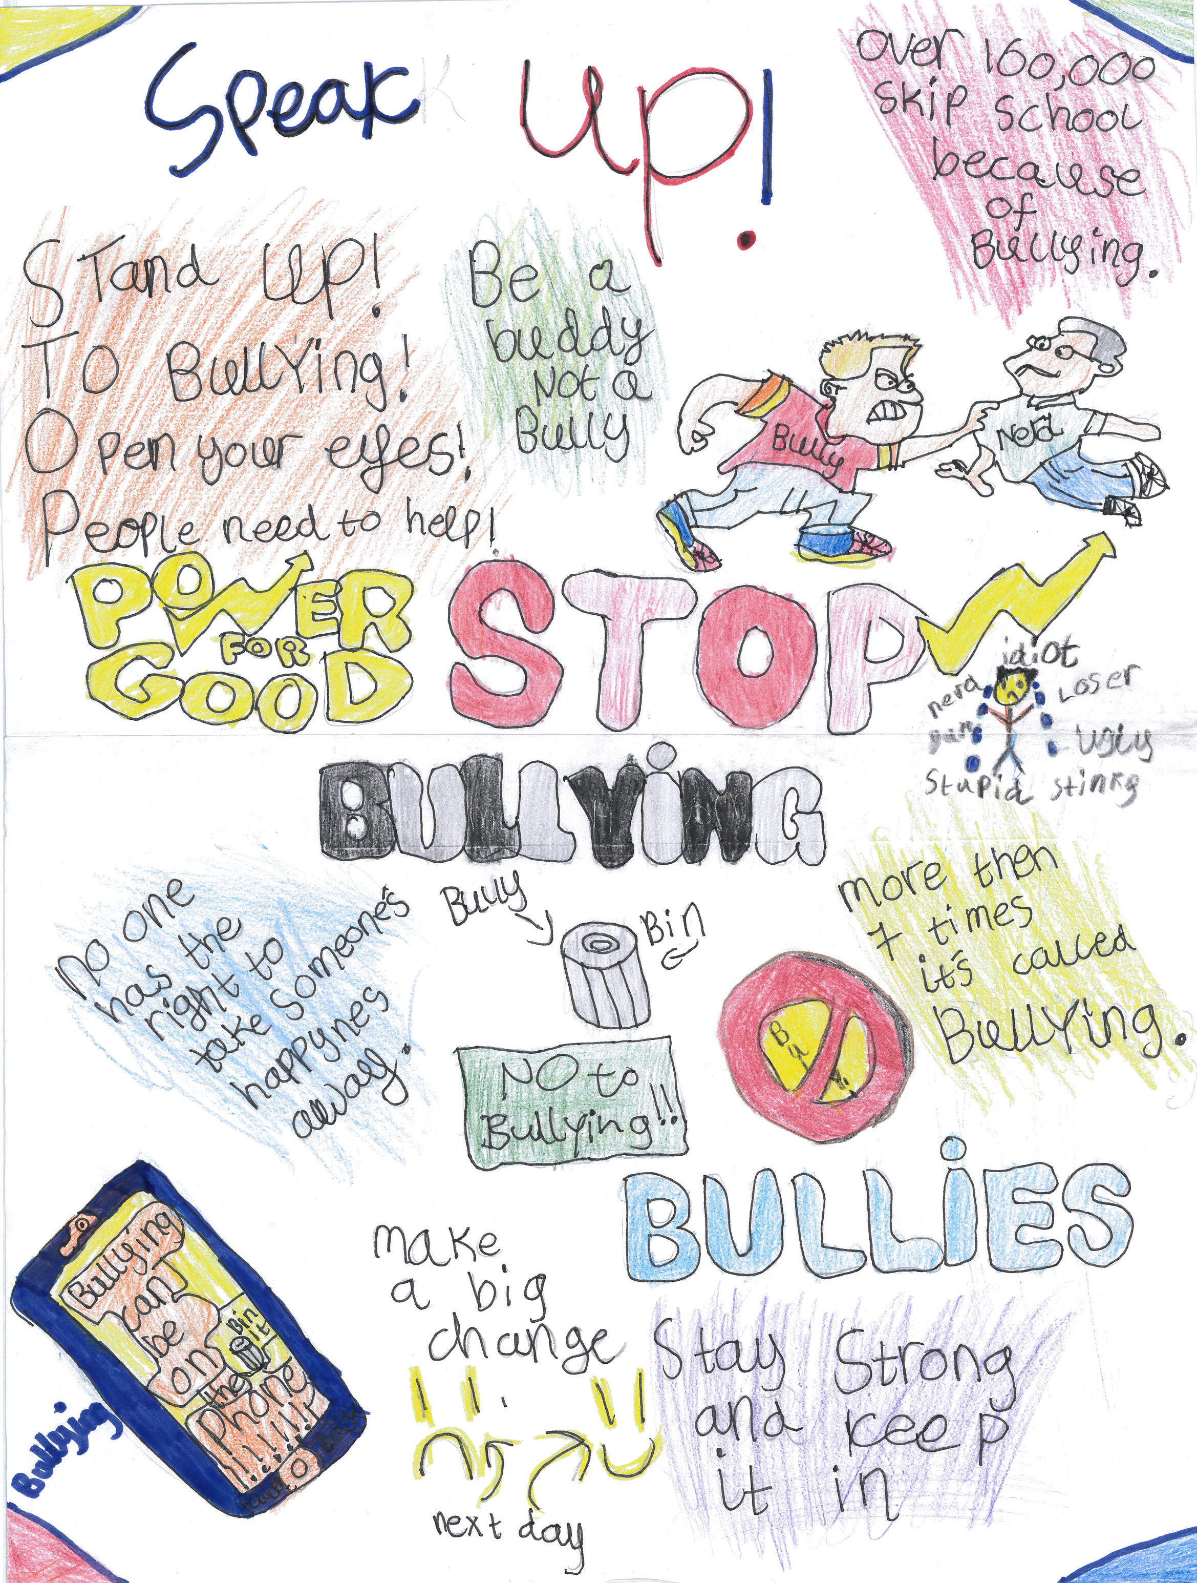

Slide 6
Strategies employed
School council
Anti-bullying champion invited to meet with the school council
School council suggested introduction of a ‘ Anti-bullying class charter’
Lead a whole school assembly on anti-bullying
Learning mentors- follow a restorative approach to support victims and aggressors
Meet and greet
Run social skills sessions at lunchtime
Guided imagery
Inter-active play

Slide 7
Other support mechanisms
Lunchtime leaders, Curriculum Crew
SENCo/ Behaviour support team
Playground zones- Green area (climbing frames etc), gym, ball court, reflective area.
Lunch time cubs- gardening club, reading
Sports-Skipping Henry
STOP boxes
‘Say no to Bullying’ booklets to parents

Slide 8
Curriculum
PSHE cross- curricular links: Art, drama, music, PSHE, R.E
SMSC, British values
Circle time

Slide 9
Behaviour plans to support vulnerable pupils
Monitoring of attendance
Newsletters
Posters around school
Anti-bullying assemblies-1) Anti-bullying and e-safety
2) Paul Sturgess-May
3) school council
4) Head teacher-October
5) Class assembly-February
6) NSPCC /Whole school/ workshops

Slide 10
This week 13th November 2017 All Different – All Equal
Safeguarding Team
Anti-bullying week Assembly
Wrist Bands
Class Charter

