Slide 1
No Outsiders in Our School
LCC Pilot project 2017/18

Slide 2
“Everyone is an insider, no matter what their beliefs, whatever their colour, gender or sexuality”
Desmond Tutu (2004)
Notes:
NO approach was developed by Andrew Moffat, teacher in Birmingham and the name came from this inspirational quote from Desmond Tutu – this is what we aspire to, a school or a world where all difference is truly celebrated and no one is made to feel like an outsider because of their background.

Slide 3
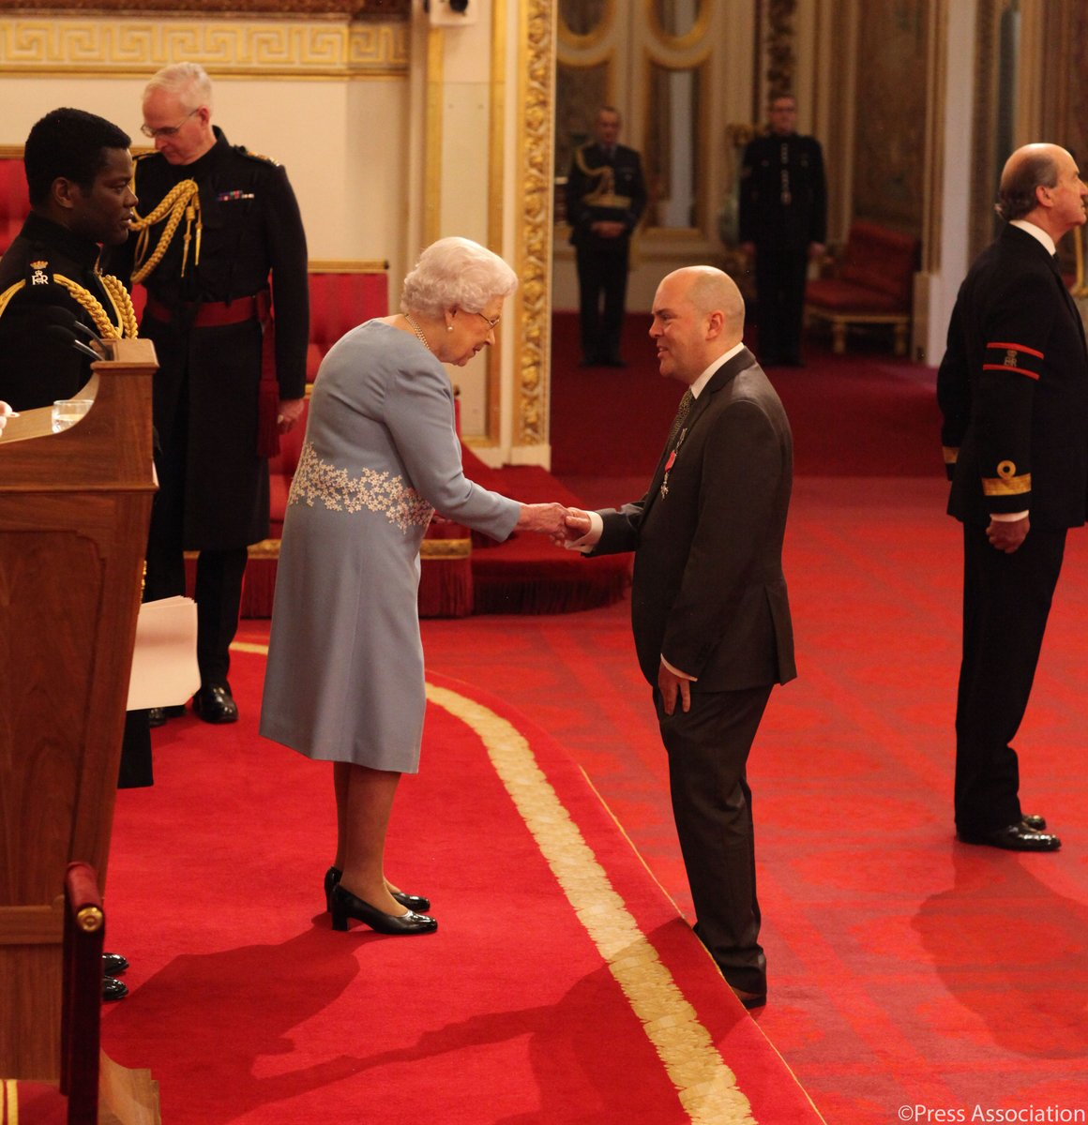

Slide 4
The law
The Equality Act (2010) protects individuals from discrimination in the workplace as employees and in wider society as service users. It covers these protected characteristics:
age
disability
marriage and Civil Partnership
gender reassignment
Pregnancy or maternity
Religion or belief
race
sexual orientation
sex
Notes:
The statutory codes of practice regarding The Equality Act (2010) protects individuals from discrimination in the workplace as employees and in wider society as service users. It covers these protected characteristics:
age
disability
marriage and Civil Partnership
gender reassignment
Pregnancy or maternity
Religion or belief
race
sexual orientation
sex

Slide 5
The Law
Section 149 of the Equality Act sets out the Public Sector Equality Duty
The Public Sector Equality Duty requires that public bodies:
eliminate discrimination
Advance equality
Foster good relations
Notes:
Section 149 of the Equality Act sets out the Public Sector Equality Duty all public bodies, including schools, have to consider when carrying out their day to day work, in shaping policy, delivering services and recruiting and managing their own employees.
The Public Sector Equality Duty requires that public bodies:
eliminate discrimination against anyone because of their protected characteristic
Advance equality of opportunity for all service users and for all employees
Foster good relations between different people when carrying out their activities

Slide 6
The Law
Illegal to ignore aspects of the Equality Act.
So we cannot promote an ethos where people of diverse faith or age are welcome but those of diverse sexual orientation or ability are not.
Preparing children for the world and workplace beyond school
Notes:
What is clear here, is that public bodies (including schools and academies) paying regard to some of the protected characteristics of the Act and not to others, is simply against the law.
So we cannot promote an ethos where people of diverse faith or age are welcome but those of diverse sexual orientation or ability are not.
Similarly, children need to be taught this fundamental value within the law, as when they leave school and get a job, they will not stay employed for long if they are not respectful of all individuals in the workplace.

Slide 7
What is No Outsiders about?
Teaching children to respect and accept difference and diversity
Using the Equality Act 2010 (British Law) as a solid foundation
Taking a proactive approach to bullying
Reducing potential for radicalisation
Preparing children for life in Modern Britain
Teaching “British Values”
Notes:
Bullying is far less likely to exist in an environment which fosters inclusion, respect, celebrates diversity and where children work and play with others from a range of diverse backgrounds.

Slide 8
What is No Outsiders?
Brain child of Andrew Moffatt
Equality promoted through the curriculum
Lesson plans for every primary school year group
Notes:
No Outsiders is a resource and framework for teaching the Equalities Act in Primary Schools, developed by Andrew Moffatt.
This resource provides schools with a curriculum that promotes equality for all sections of the community and all equalities covered by the Equality Act.
The resource pack includes five lesson plans for every primary school year group (EYFS-Yr 6) based upon a selection of 35 picture books.

Slide 9
The books

Slide 10
Questions
Thoughts as a professional?
Thoughts as a parent/auntie/sister/uncle/brother etc.
Anything you like?
Anything you don’t like?
Potential barriers?
Anything else?

Slide 11
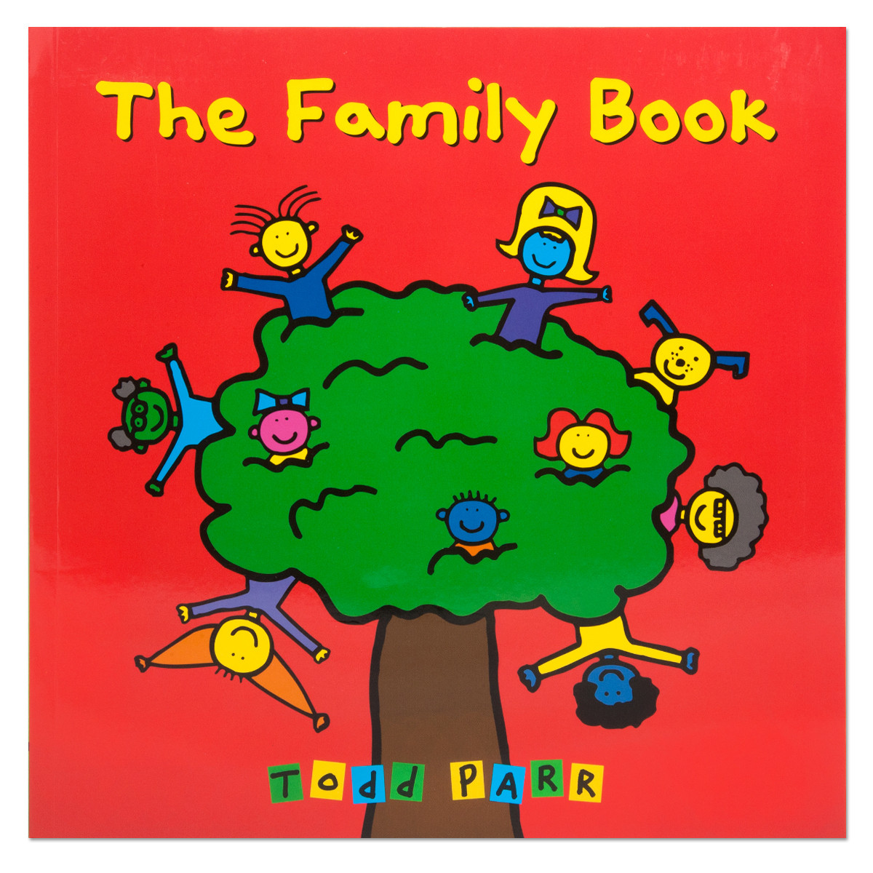
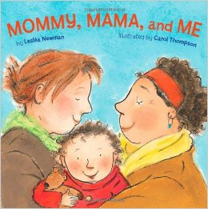
Notes:
EYFS
Family Book – Book which introduces children to a range of different families through words and pictures of animals. Doesn’t use any formal words or phrases but just introduces differences and celebrates it. It also highlights that although we’re all different, we have certain things in common.
Mommy Mama and Me – Classic rhyming story about a girl and her family, except this family is 2 mums and a daughter and it just talks us through the things they like to do together.
Lesson plans that come with these books are just a way of helping kids to explore difference and reflect on their own families – don’t actually name or label certain families like looked after, gay, traveller, etc.

Slide 12
Notes:
My world – Simple fun and colourful book which introduces cultural differences between children whilst also their highlighting similarities
Max the Champion – Story about a mad keen sportsman Max and all the varied sports he loves and daydreams about – as we get to know Max and his friends a bit better, we learn more about their physical needs and disabilities. The book doesn’t make this explicit and this really helps to normalise difference in abilities – the lesson plans start to unpick these a bit more.

Slide 13
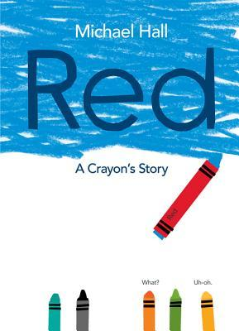
Notes:
Red – Story about a crayon called Red but who just wasn’t very good at it….couldn’t do any of the things he or his friends and family thought he was supposed to – draw in red. No matter how hard he tried, or how others tried to make him do what he was supposed to, he just kept getting it wrong. Some of his friends and family teased him or got angry with him and Red felt sad and frustrated….until one day, someone asked him to try something a bit different and just accept what he was, rather than try and be what others thought he should be…and Red finally realised who he was…the label had been wrong all the time. Once Red realised this, others began to embrace him for who he was.
My Princess Boy – Story about a little boy who loves pink and sparkly things. Sometime he wears dresses and sometimes he wears jeans. He likes to wear his princess tiara, even when climbing trees. He’s a princess boy and his family love him exactly the way he is.
Tango Makes Three - It tells the true story of Roy and Silo, two chinstrap penguins at New York's Central Park Zoo who became a couple in 1998. When another penguin couple had an extra egg that they couldn't look after, a zookeeper gave the egg to Roy and Silo who were nurturing an egg-shaped rock at the time, and they raised a daughter, called Tango.

Slide 14
The impact
“The school’s work to promote pupils’ personal development and welfare is outstanding and is a strength of the school. Pupils’ understanding of tolerance, diversity, respect, rights and responsibilities, and equal opportunity is enhanced through thought-provoking teaching and other activities such as assemblies and visits to places of worship. The school’s work on ‘No outsiders in our school’ actively promotes fundamental British values and teaches pupils how to make a positive contribution to local, national and international communities. Prejudices and stereotypes are confronted and challenged. As a result, pupils play and work together happily and with confidence and all pupils have equal opportunities to succeed and do well.”
‘Outstanding’ Ofsted report, May 2016
Notes:
The No Outsiders approach has been implemented in several Birmingham City Schools, the most recent being Parkfield Primary School.
Parkfield is located in inner-city Birmingham with a 98.8% Muslim population. The project began in 2015/15 and has since received extremely positive feedback:-

Slide 15
The impact
95% of children at Parkfield Community School say they like being in a school where people are different.
96.5% of children at Parkfield Community School say they can get along with people who follow a different religion to them.
Whole School Questionnaire, July 2016

Slide 16
“Our official BCC position now is that we support No Outsiders as the best way to teach about these issues…we like the way that No Outsiders embed LGBT issues within the Equality Act.”
Colin Diamond, Birmingham Director of Education, July 2016
“The results of his work are amazing”
The Guardian, February 2016
“Simultaneously promoting diversity and tackling disadvantage, Parkfield Community School is a fantastic example of what great Primaries can accomplish”
Teach Primary, September 2016

Slide 22
